Slide 1


Securing and Scaling the Network Infrastructure for ITC University
Network Design and Implementation for multi branch Campus

Slide 2
Introduction
Overview of ITC University
Operates across two campuses.
Serves approximately 25,000 users.
Growth Projections
Anticipated doubling of users by 2030.
Project Goal
Design and implement a scalable, secure, and reliable network infrastructure.

Slide 3
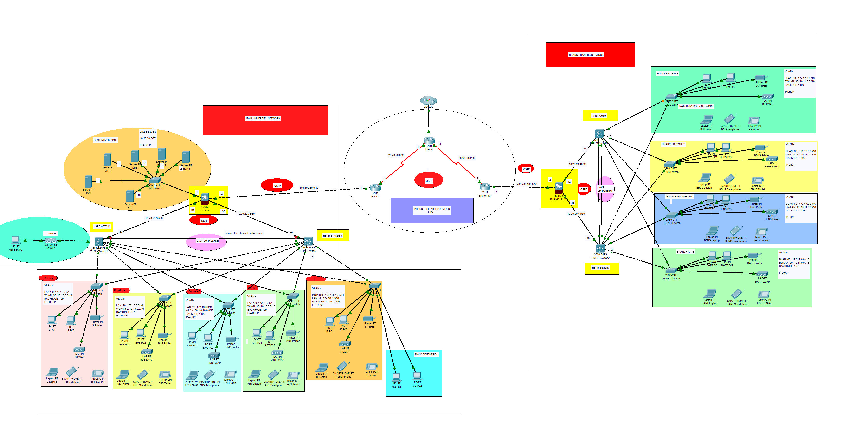
ITC Network Diagram

Slide 4
Project Objectives
Network Scalability
Design a network capable of accommodating a growing user base.
Security
Implement robust security measures to protect data.
Redundancy
Ensure high availability and minimize downtime.
Seamless Connectivity
Facilitate secure communication between campuses.
Robust Management
Manage the network with VLANs, firewalls, and access controls.

Slide 5
Network Design Overview
Hierarchical Design Model
Enhances scalability, redundancy, and ease of management.
Three Layers of the Design
Core Layer: Centralized management using multilayer switches (Catalyst 3650).
Distribution Layer: Interconnects various VLANs and enables inter-VLAN routing.
Access Layer: Connects individual faculties and departments using Catalyst 2960 switches.

Slide 6
Key Protocols and Technologies
Routing and Switching Protocols
OSPF for dynamic routing.
LACP EtherChannel for increased bandwidth.
HSRP for redundancy and high availability.
Traffic Management and Security
STP PortFast and BPDUguard to prevent loops.
ACLs for traffic management.
Network Addressing
NAT for IP management.

Slide 7
VLAN Segmentation
Purpose of VLANs
Increase security and improve network performance.
VLAN Assignments
VLAN 10: Management (192.168.10.0/24)
VLAN 20 & 60: LAN (172.16.0.0/16, 172.17.0.0/16)
VLAN 50 & 90: WLAN (10.10.0.0/16, 10.11.0.0/16)
VLAN 199: Blackhole VLAN for unused ports.
Inter-VLAN Routing
Achieved via core multilayer switches.

Slide 8
Implementation Phases Overview
Phases of Implementation
A systematic approach to project execution.
Key Goals of Each Phase
Planning, design, configuration, and security enhancements.

Slide 9
Phase 1 - Planning and Requirements Gathering
Goals
Identify current and future network requirements.
Key Actions
Meetings with university IT staff to assess operational needs.
Evaluation of the current infrastructure for scalability.

Slide 10
Phase 2 - Network Design and Scalability Considerations
Design Highlights
Implemented EtherChannel (LACP) for link aggregation.
Enabled STP PortFast and BPDUguard for network protection.
Future Growth
Designed to support up to 50,000 users by 2030.

Slide 11
Phase 3 - Hardware and Software Configuration
Hardware Setup
Cisco ASA 5506-X firewalls.
Catalyst 3650 and 2960 switches.
Wireless LAN Controllers (WLC) for managing access points.
Software Setup
Configured OSPF routing protocol for dynamic routing.
Established basic security settings (hostnames, passwords, SSH).

Slide 12
Phase 4 - Security Enhancements
Goals
Ensure secure communication across the network.
Key Actions
Configuration of Cisco ASA Firewalls for security zones.
Established ACLs to restrict administrative access.

Slide 13
Key Technologies and Components
Firewalls and Security Zones
Use of Cisco ASA 5506-X firewalls for secure segmentation.
Routing and Switching Infrastructure
Multilayer switches for data forwarding and routing.
Wireless LAN Infrastructure
Centrally managed wireless network with WLC.

Slide 14
Addressing and Subnetting
Subnetting Details
Management: 192.168.10.0/24
WLAN: 10.10.0.0/16 (Main), 10.11.0.0/16 (Branch)
DMZ: 10.20.20.0/27
LAN: 172.16.0.0/16 (Main), 172.17.0.0/16 (Branch)
Public Addressing
105.100.50.0/30 (Main), 205.200.100.0/30 (Branch)

Slide 15
Challenges and Solutions
Challenge 1: Ensuring secure communication while maintaining performance.
Solution: Implemented VLANs and access controls with OSPF.
Challenge 2: Providing a scalable solution for future growth.
Solution: Designed with ample IP space and modular VLAN segmentation.

Slide 16
Final Testing and Results
Testing Overview
Inter-VLAN Routing: Confirmed successful communication.
ACL and Firewall Rules: Tested security policies.
Performance Testing: Verified speed and redundancy.

Slide 17
Conclusion
Summary
The network for ITC University is robust, scalable, and secure.
Capable of handling anticipated growth and ensuring secure communication.
Future Readiness
Prepared for future demands and technology advancements.

